Slide 1

Variable, expression
Unit 2

Slide 2
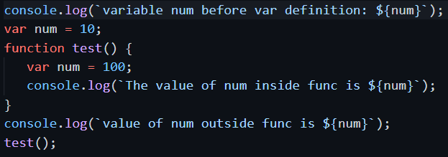
Use ‘Var’ to declare variable
In one .js file, use var to define variables. It has 2 scope: global, local.
Global: outside of any function. Valid the whole file.
Local: inside a function. Valid only in the function.
Can declare more than once.
Identifier ‘num’ is valid, but value is undefined
Value is global variable’s, 10
Run the function.
Value is local variable’s, 100

Slide 3
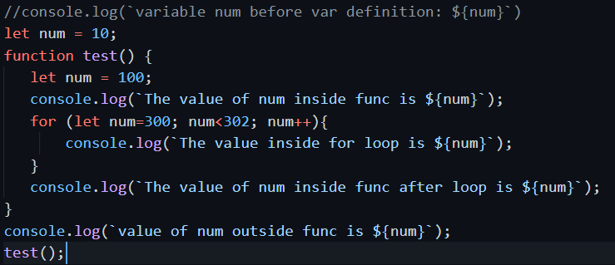
Use ‘let’ to declare variable
New in ES6 script. Block scope
Cannot declare more then once in the same block for same variable
Must be used after let declare, cannot use it before declare.
Will result in error if uncomment it.
Declare new variable in function block.
Gives value 100
Declare new variable in loop block.
Gives value 300, 301
Will give the global block variable’s value 10.
Call to test function

Slide 4
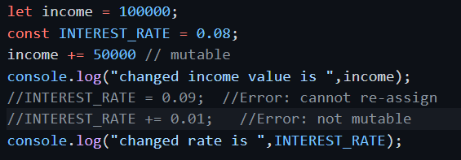
Use ‘const’ to declare constants
Cannot be re-declared.
Can only take value when declared (initializer). Cannot be re-assigned new value. Immutable.
Like let, is block scope

Slide 5
Expressions, operators
A special kind of statement evaluates to value
Has: operands (the data), operators (how to process the data)

Slide 6
Arithmetic operators
Operator | Function | Example(a=10,b=5)
+ | Addition: Returns the sum of the operands. | a + b is 15
- | Subtraction: Returns the difference of the values. | a-b is 5
* | Multiplication: Returns the product of the values. | a*b is 50
/ | Division: Performs a division operation and returns the quotient. | a/b is 2
% | Modulus: Performs a division and returns the remainder. | a%b is 0
++ | Increment: Increments the value of the variable by one. | a++ is 11
-- | Decrement: Decrements the value of the variable by one. | a-- is 9
** − Power / Exponentiation

Slide 7
Relation operators
Operators | Description | Example(A=10,B=20)
> | Greater than | (A > B) is false
< | Lesser than | (A < B) is true
>= | Greater than or equal to | (A >= B) is false
<= | Lesser than or equal to | (A <= B) is true
== | Equality | (A == B) is false
!= | Not Equal | (A!= B) is true

Slide 8
Logical operators
Operators | Description | Example(A=10,B=20)
&& | And The operator returns true only if all the expressions specified return true. | (A > 10 && B > 10) is False
|| | Or The operator returns true if at least one of the expressions specified return true. | (A > 10 || B > 10) is True
! | Not The operator returns the inverse of the expression’s result. For E.g.: !(7>5) returns false. | !(A > 10) is True

Slide 9
Assignment operators
Sr.No | Operator & Description
1 | = (Simple Assignment) Assigns values from the right side operand to the left side operand. Example − C = A + B will assign the value of A + B into C
2 | += (Add and Assignment) It adds the right operand to the left operand and assigns the result to the left operand. Example − C += A is equivalent to C = C + A
3 | -= (Subtract and Assignment) It subtracts the right operand from the left operand and assigns the result to the left operand. Example C -= A is equivalent to C = C - A
4 | *= (Multiply and Assignment) It multiplies the right operand with the left operand and assigns the result to the left operand. Example C *= A is equivalent to C = C * A
5 | /= (Divide and Assignment) It divides the left operand with the right operand and assigns the result to the left operand.

Slide 10

Conditional operator
Test ? expr1 : expr2
Test − Refers to the conditional expression
expr1 − Value returned if the condition is true
expr2 − Value returned if the condition is false

Slide 11
Bitwise operators
Operators | Usage | Description
&, | a & b | Bitwise AND Returns a one in each bit position for which the corresponding bits of both operands are ones
|, | a | b | Bitwise OR Returns a one in each bit position for which the corresponding bits of either or both operands are ones
^ | a^b | Bitwise XOR Returns a one in each bit position for which the corresponding bits of either but not both operands are ones
~ | ~ a | Bitwise NOT Inverts the bits of its operand
<< | a << b | Left shift Shifts a in binary representation b (< 32) bits to the left, shifting in zeroes from the right
>> | a >> b | Sign-propagating right shift Shifts a in binary representation b (< 32) bits to the right, discarding bits shifted off
>>> | a >>> b | Zero-fill right shift Shifts a in binary representation b (< 32) bits to the right, discarding bits shifted off, and shifting in zeroes from the left

